Slide 1
Chapter 5
Top-Down Parsing

Slide 2
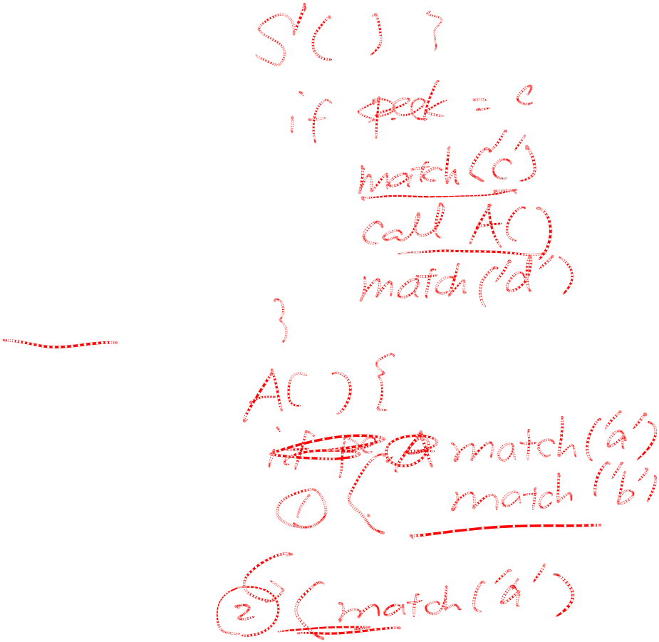
Recursive Descent Parser
Consider the grammar:
S → c A d
A → ab | a
The input string is “cad”

Slide 3
Recursive Descent Parser (Cont.)
Build parse tree:
step 1. From start symbol.
S
c A d

Slide 4
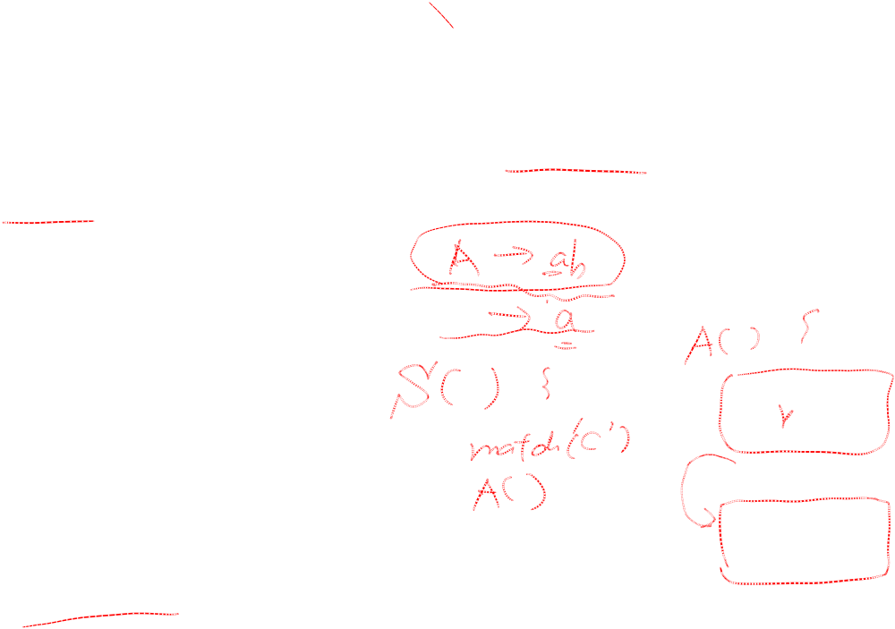
Recursive Descent Parser (Cont.)
Step 2. We expand A using the first alternative A → ab to obtain the following tree:
S
c A d
a b

Slide 5

Recursive Descent Parser (Cont.)
Now, we have a match for the second input symbol “a”, so we advance the input pointer to “d”, the third input symbol, and compare d against the next leaf “b”.
Backtracking
  Since “b” does not match “d”, we report failure and go back to A to see whether there is another alternative for A that has not been tried - that might produce a match!
  In going back to A, we must reset the input pointer to “a”.

Slide 6
Recursive Descent Parser (Cont.)
Step 3.
S
c A d
a

Slide 7
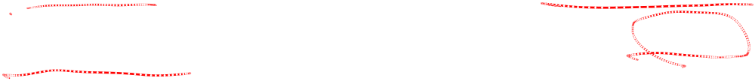
Creating a top-down parser
Top-down parsing can be viewed as the problem of constructing a parse tree for the input string, starting form the root and creating the nodes of the parse tree in preorder.
An example follows.

Slide 8
Creating a top-down parser (Cont.)
Given the grammar :
  E → TE’
  E’ → +TE’ | λ
  T → FT’
  T’ → *FT’ | λ
  F → (E) | id
The input: id + id * id

Slide 9
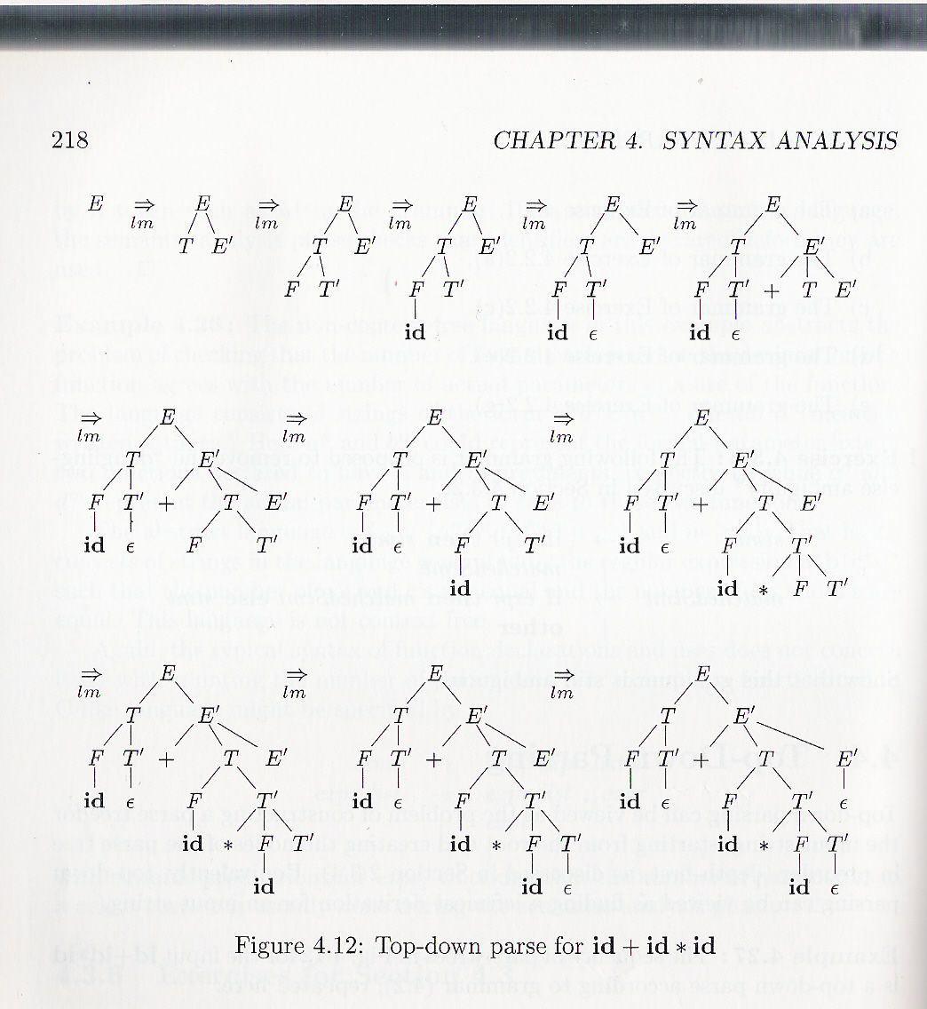
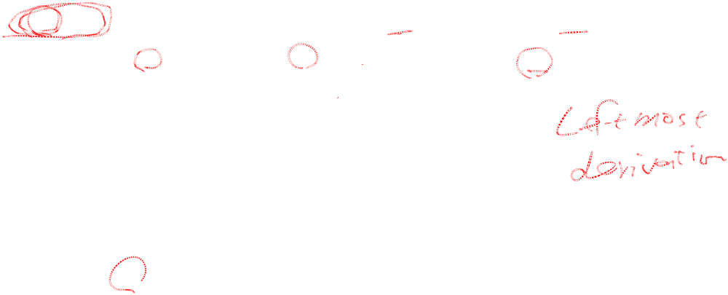
Creating a top-down parser (Cont.)

Slide 10

Top-down parsing
A top-down parsing program consists of a set of procedures, one for each non-terminal.
Execution begins with the procedure for the start symbol, which halts and announces success if its procedure body scans the entire input string.

Slide 11
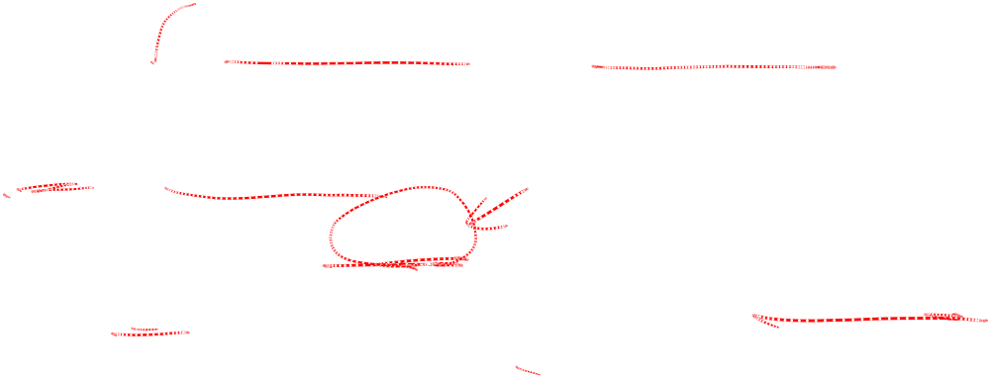
Top-down parsing
A typical procedure for non-terminal A in a top-down parser:
boolean A() {
choose an A-production, A → X1 X2 … X_{k};
for (i= 1 to k) {
if (Xi is a non-terminal)
call procedure Xi();
else if (Xi matches the current input token “a”)
advance the input to the next token;
else /* an error has occurred */;
}
}

Slide 12

NOTE

Slide 13
Top-down parsing
Given a grammar:
input → expression
expression → term rest_expression
term → ID | parenthesized_expression
parenthesized_expression → ‘(‘ expression ‘)’
rest_expression → ‘+’ expression | λ

Slide 14
Top-down parsing
For example:
input:
ID + (ID + ID)

Slide 15

Top-down parsing
Build parse tree:
start from start symbol to invoke:
int input (void)
input
expression $
Next, invoke expression()

Slide 16
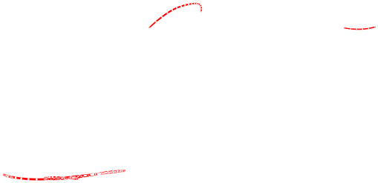
Top-down parsing
input
expression $
term rest_expression
Next, invoke term()

Slide 17
Top-down parsing
input
expression $
term rest_expression
ID
select term → ID (matching input string “ID”)

Slide 18
Top-down parsing
Invoke rest_expression()
input
expression $
term rest_expression
ID + expression

Slide 19
Top-down parsing
The parse tree is:
input
expression $
term rest_expression
ID + expression
term rest_expression
parenthesized_expression λ
( expression )
term rest_expression
ID + expression
term rest_expression
ID λ

Slide 20
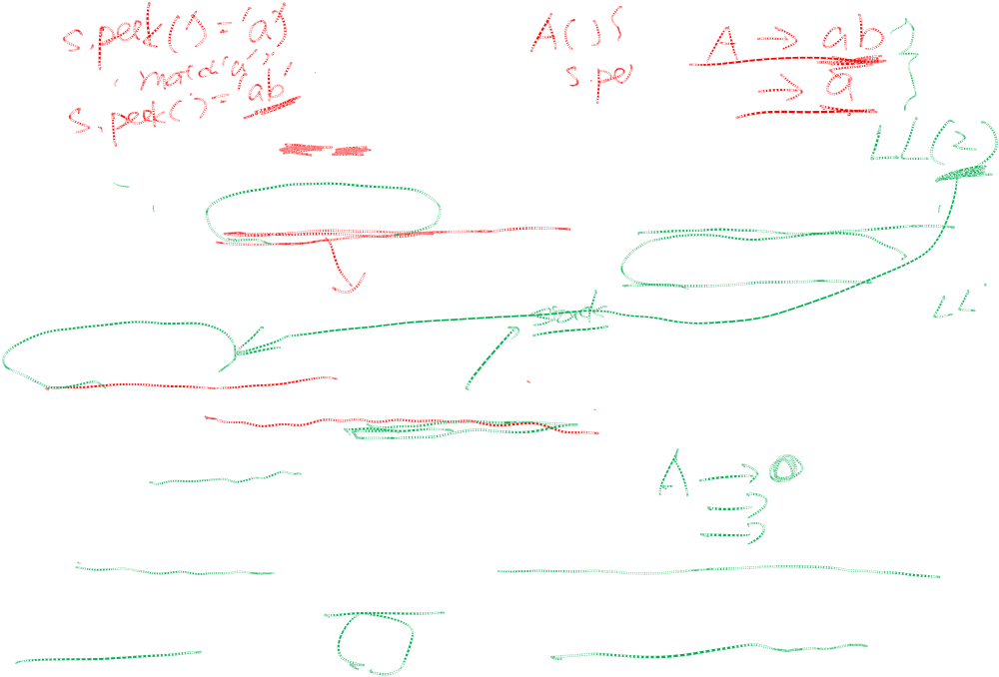
LL(1) Parsers
The class of grammars for which we can construct predictive parsers looking k symbols ahead in the input is called the LL(k) class.
Predictive parsers, that is, recursive-descent parsers without backtracking, can be constructed for the LL(1) class grammars.
The first “L” stands for scanning input from left to right. The second “L” for producing a leftmost derivation. The “1” for using one input symbol of look-ahead at each step to make parsing decisions.

Slide 21
LL(1) Parsers (Cont.)
A → α | β are two distinct productions of grammar G, G is LL(1) if the following 3 conditions hold:
FIRST(α) cannot contain any terminal in FIRST(β).
2. At most one of α and β can derive λ.
3. if β →* λ, FIRST(α) cannot contain
any terminal in FOLLOW(A).
if α →* λ, FIRST(β) cannot contain
any terminal in FOLLOW(A).

Slide 22
Some helping examples
S → AC
A → a | B let’s look at this production
B → b | λ
because A has two choices to derive, a and B, but B can →* λ (that is λ is in First(B) = {b, λ} ) so, if B does be derived into a λ, we can still have a chance if we can check the follow set of A. In other words, A must appear on RHS in other productions rule. Suppose A derive into a λ, we want to know what symbols follow A. In this example, FOLLOW(A) = FIRST(C);

Slide 23
Construction of a predictive parsing table
The following rules are used to construct the predictive parsing table:
  1. for each terminal a in FIRST(α),
  add A → α to matrix M[A,a]
  2. if λ is in FIRST(α), then
  for each terminal b in FOLLOW(A),
  add A → α to matrix M[A,b]

Slide 24
LL(1) Parsers (Cont.)
Given the grammar:
input → expression 1
expression → term rest_expression 2
term → ID 3
| parenthesized_expression 4
parenthesized_expression → ‘(‘ expression ‘)’ 5
rest_expression → ‘+’ expression 6
| λ 7
Build the parsing table.

Slide 25
LL(1) Parsers (Cont.)
FIRST (input) = FIRST(expression)
=FIRST (term) = {ID, ‘(‘ }
FIRST (parenthesized_expression) = { ‘(‘ }
FIRST (rest_expression) = { ‘+’ λ}
FOLLOW (input) = {$ }
FOLLOW (expression) = {$ ‘)’ }
FOLLOW (term) =
FOLLOW (parenthesized_expression) = {$ ‘+’ ‘)’}
FOLLOW (rest_expression) = {$ ‘)’}

Slide 26
LL(1) Parsers (Cont.)
Non-terminal | Input symbol
 | ID | + | ( | ) | $
Input | 1 |  | 1
Expression | 2 |  | 2
Term | 3 |  | 4
parenthesized_expression |  |  | 5
rest_expression |  | 6 |  | 7 | 7

Slide 27
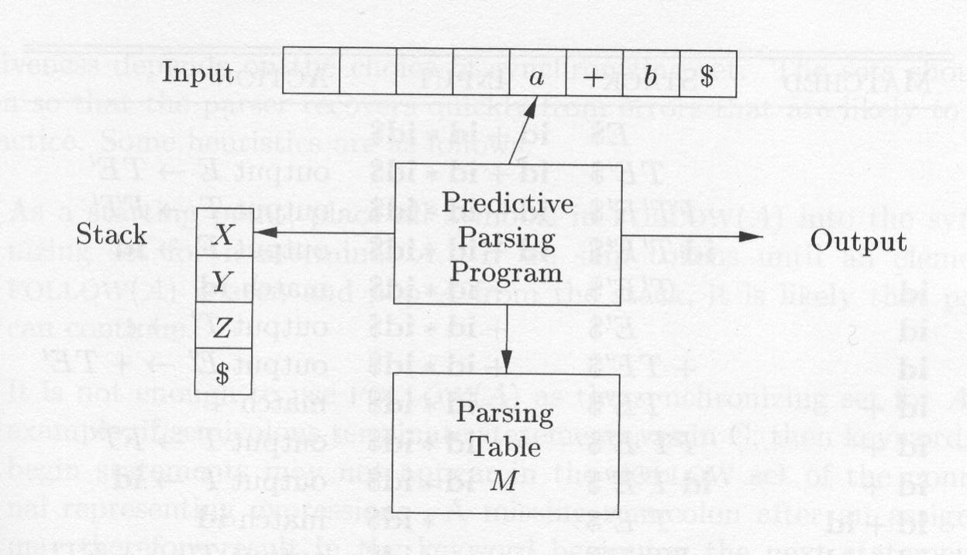
Model of a table-driven predictive parser

Slide 28
Predictive parsing algorithm
Set input pointer (ip) to the first token a;
Push $ and start symbol to the stack.
Set X to the top stack symbol;
while (X != $) { /*stack is not empty*/
if (X is token a) pop the stack and advance ip;
else if (X is another token) error();
else if (M[X,a] is an error entry) error();
else if (M[X,a] = X → Y₁Y₂…Y_{k}) {
output the production X → Y₁Y₂…Y_{k};
pop the stack; /* pop X */
/* leftmost derivation*/
push Y_{k},Yk-1,…, Y₁ onto the stack, with Y₁ on top;
}
set X to the top stack symbol Y1;
} // end while

Slide 29
LL(1) Parsers (Cont.)
Given the grammar:
  E → TE’ 1
  E’ → +TE’ 2
  E’ → λ 3
  T → FT’ 4
  T’ → *FT’ 5
  T’ → λ 6
  F → (E) 7
  F → id 8

Slide 30
LL(1) Parsers (Cont.)
FIRST(F) = FIRST(T) = FIRST(E) = {（, id }
FIRST(E’) = {＋, λ}
FIRST(T’) = { ﹡, λ}
FOLLOW(E) = FOLLOW(E’) = {）, ＄}
FOLLOW(T) = FOLLOW(T’) = {＋, ）, ＄}
FOLLOW(F) = {＋, ＊, ）, ＄}

Slide 31
LL(1) Parsers (Cont.)
Non-terminal | Input symbols
 | Id | + | * | ( | ) | $
E | 1 |  |  | 1
E’ |  | 2 |  |  | 3 | 3
T | 4 |  |  | 4
T’ |  | 6 | 5 |  | 6 | 6
F | 8 |  |  | 7

Slide 32
LL(1) Parsers (Cont.)
Stack | Input | Output
$E | id + id * id $
$E’T | id + id * id $ | E → TE’
$E’T’F | id + id * id $ | T → FT’
$E’T’id | id + id * id $ | F → id
$E’T’ | + id * id $ | match id
$E’ | + id * id $ | T’ → λ
$E’T+ | + id * id $ | E’ → +TE’

Slide 33
LL(1) Parsers (Cont.)
Stack | Input | Output
$E’T | id * id $ | match +
$E’T’F | id * id $ | T → FT’
$E’T’id | id * id $ | F → id
$E’T’ | * id $ | match id
$E’T’F* | * id $ | T’ → *FT’
$E’T’F | id $ | match *
$E’T’id | id $ | F → id
$E’T’ | $ | match id
$E’ | $ | T’ → λ
$ | $ | E’ → λ

Slide 34
Common Prefix
In Fig. 5.12, the common prefix:
if Expr then StmtList (R1,R2)
makes looking ahead to distinguish R1 from R2 hard.
Just use Fig. 5.13 to factor it and “var”(R5,6)
The resulting grammar is in Fig. 5.14.

Slide 35
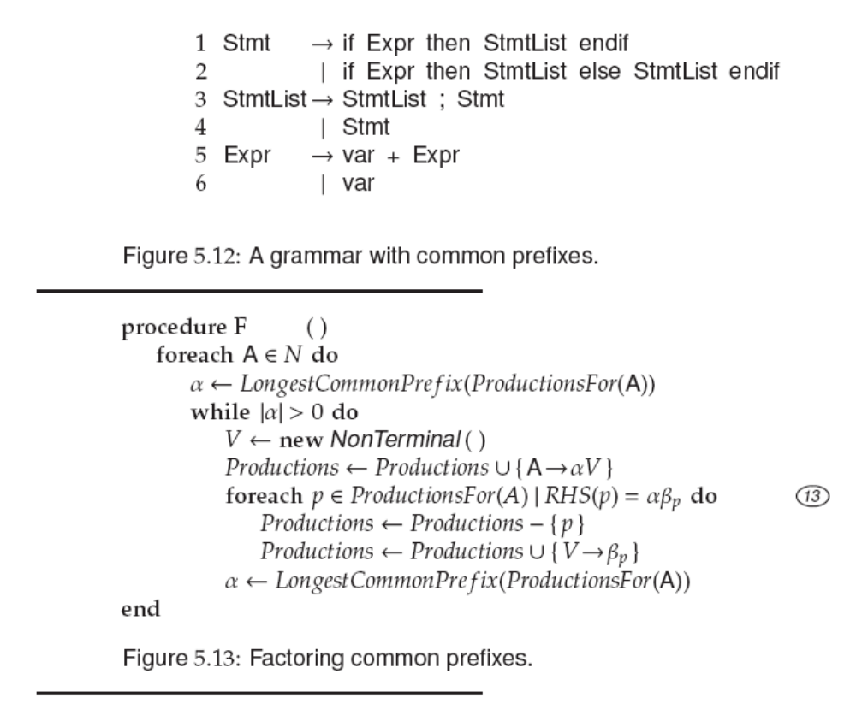

Slide 36
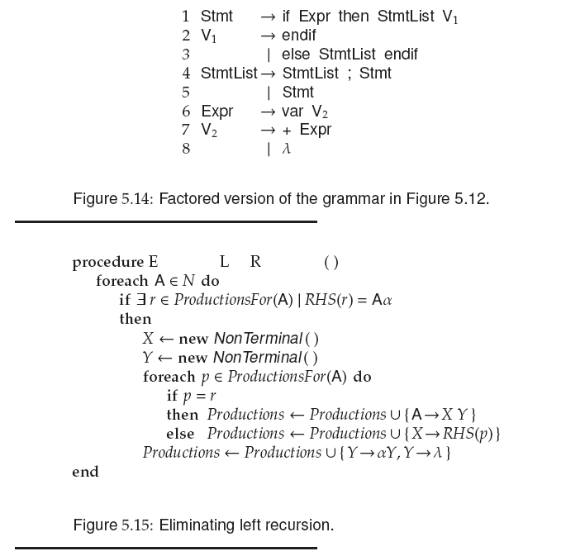

Slide 37
Left Recursion
A production is left recursive
if its LHS symbol is the first symbol of
its RHS.
In fig. 5.14, the production
StmtList→ StmtList ; Stmt
StmtList is left-recursion.

Slide 38
Left Recursion (Cont.)

Slide 39
Left Recursion (Cont.)
Grammars with left-recursive productions can never be LL(1).
  Some look-ahead symbol t predicts the application of the left-recursive production
  A → Aβ.
  with recursive-descent parsing, the application of this production will cause
  procedure A to be invoked infinitely.
  Thus, we must eliminate left-recursion.

Slide 40
Left Recursion (Cont.)
Consider the following left-recursive rules.
1. A → A α
2. | β the rules produce strings like β α α
we can change the grammar to:
1. A → X Y
2. X → β
3. Y → α Y
4. | λ the rules also produce strings like β α α
The EliminateLeftRecursion algorithm is shown in fig. 5.15.
Applying it to the grammar in fig. 5.14 results in fig. 5.16.

Slide 41
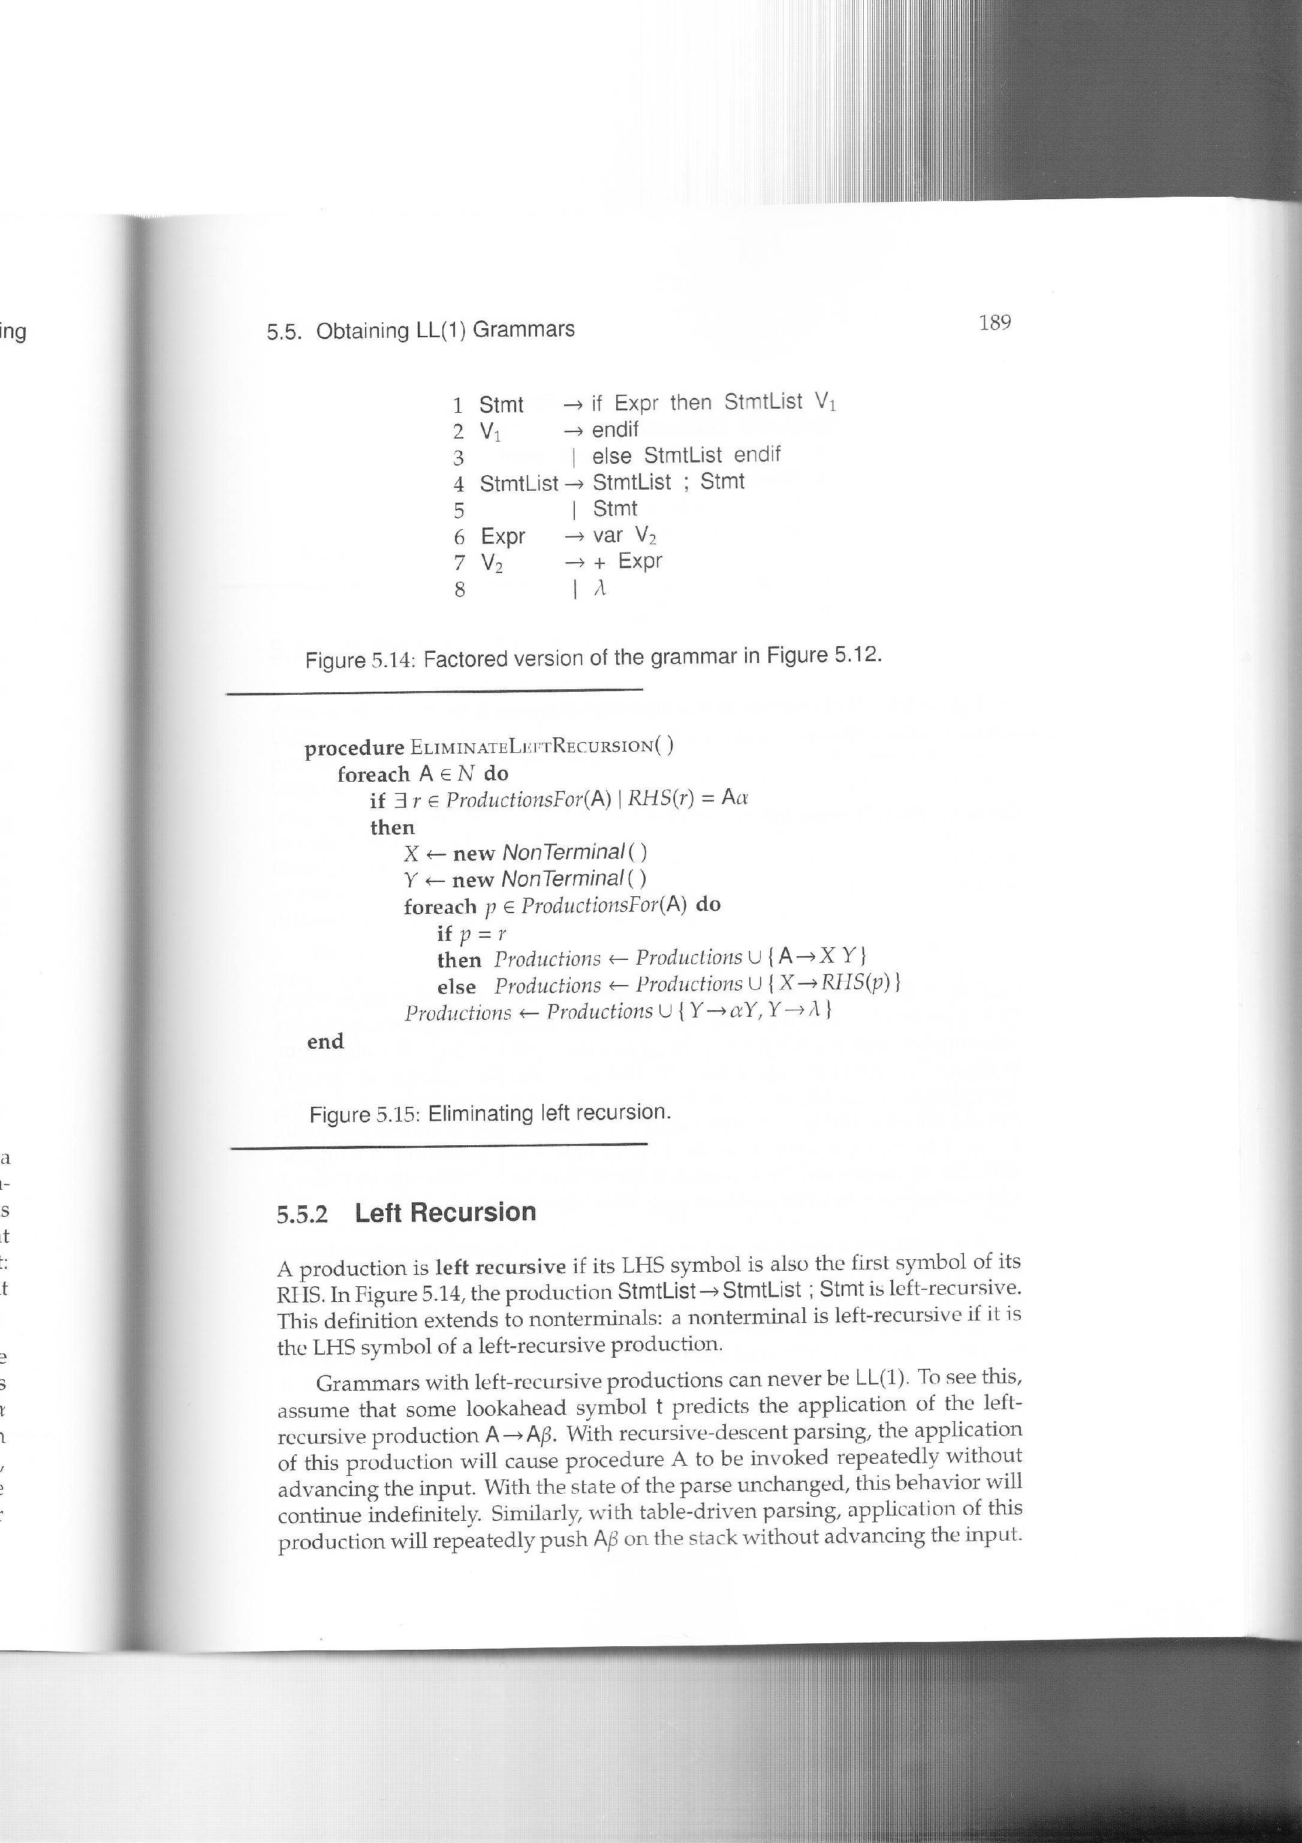
Left Recursion (Cont.)
1
2
3
4
5

Slide 42
Left Recursion (Cont.)
Now, we trace the algorithm with the grammar below:
(4) StmtList → StmtList ; Stmt
(5) | Stmt
first, the input is (4) StmtList → StmtList ; Stmt
because RHS(4) = StmtList α it is left-recursive (marker 1)
create two non-terminals X, and Y
for rule (4) (marker 2)
as StmtList = StmtList,
create StmtList → XY (marker 3)
for rule (5) (marker 2)
as StmtList != Stmt
create X → Stmt (marker 4)
finally, create Y → ; Stmt and Y → λ (marker 5)

Slide 43
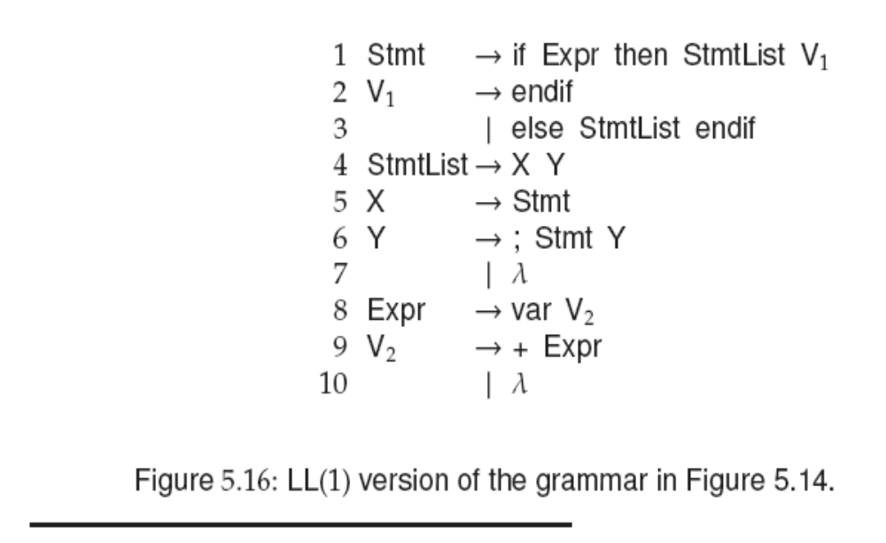

Left Recursion (Cont.)

Slide 44
Homework 1
Construct the LL(1) table for the following
grammar:
1 Expr → - Expr
2 Expr → (Expr)
3 Expr → Var ExprTail
4 ExprTail → - Expr
5 ExprTail → λ
6 Var → id VarTail
7 VarTail → (Expr)
8 VarTail → λ

Slide 45
Homework 1 Solution
First(Expr) = {-, (, id}
First(ExprTail) = {-, λ}
First (Var) = { id}
First (VarTail) = { (, λ}
Follow (Expr) = Follow (ExprTail) = {$, ) }
Follow (Var) = {$, ), -}
Follow (VarTail) = {$, ), -}

Slide 46
Homework 1 Solution (Cont.)
Non- Terminal | Input Symbol
 | - | ( | id | ) | $
Expr | 1 | 2 | 3
ExprTail | 4 |  |  | 5 | 5
Var |  |  | 6
VarTail | 8 | 7 |  | 8 | 8

Slide 47
Homework 2
Given the grammar:
  S → i E t S S’ | a
  S’ → e S | λ
  E → b
  1. Find the first set and follow set.
  2. Build the parsing table.

Slide 48
Homework 2 Solution
First(S) = {i, a}
First(S’) = {e, λ}
First (E) = {b}
Follow (S) = Follow (S’) = {$, e}
Follow (E) = {t}

Slide 49
Homework 2 Solution (Cont.)
Non- Terminal | Input Symbol
 | a | b | e | i | t | $
S | 2 |  |  | 1
S’ |  |  | 3/4 |  |  | 4
E |  | 5
As First(S’) contains λ and Follow (S’) = {$, e} So rule 4 is added to e, $.
3/4 (rule 3 or 4) means an error. This is not LL(1) grammar.

